Slide 1
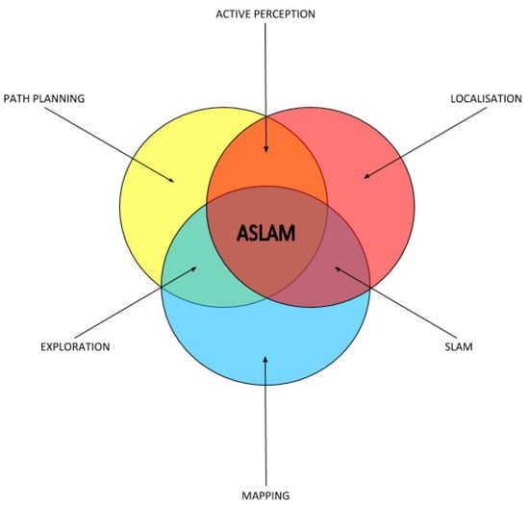
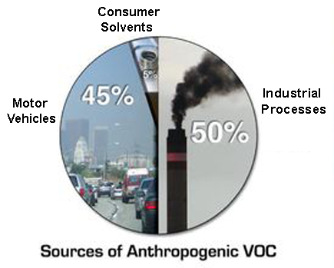
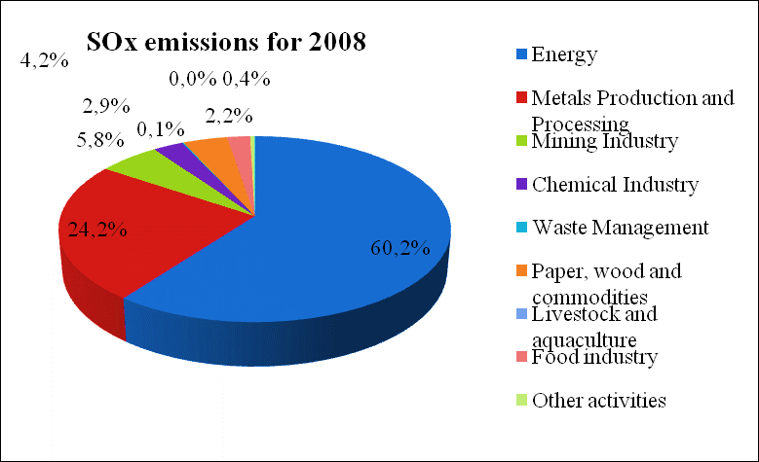
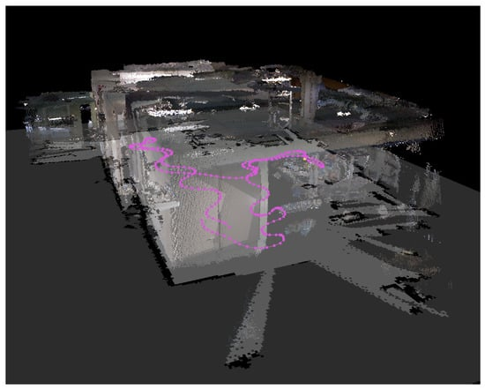
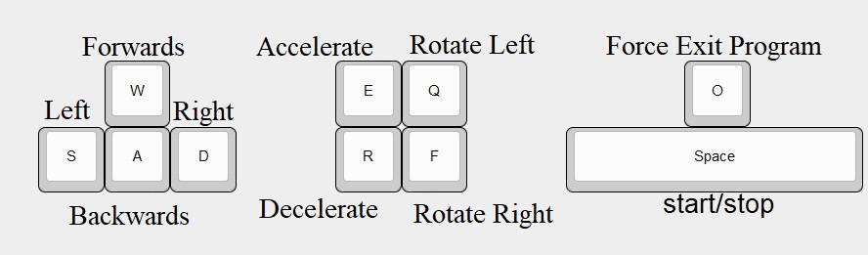
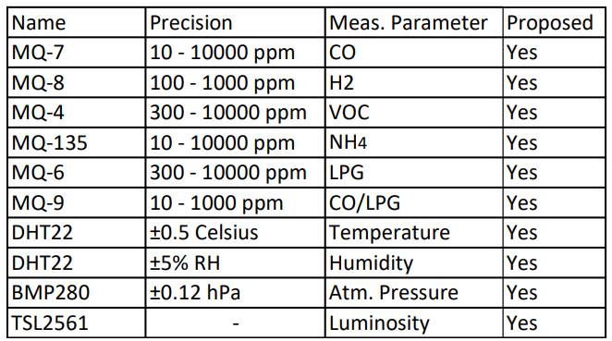
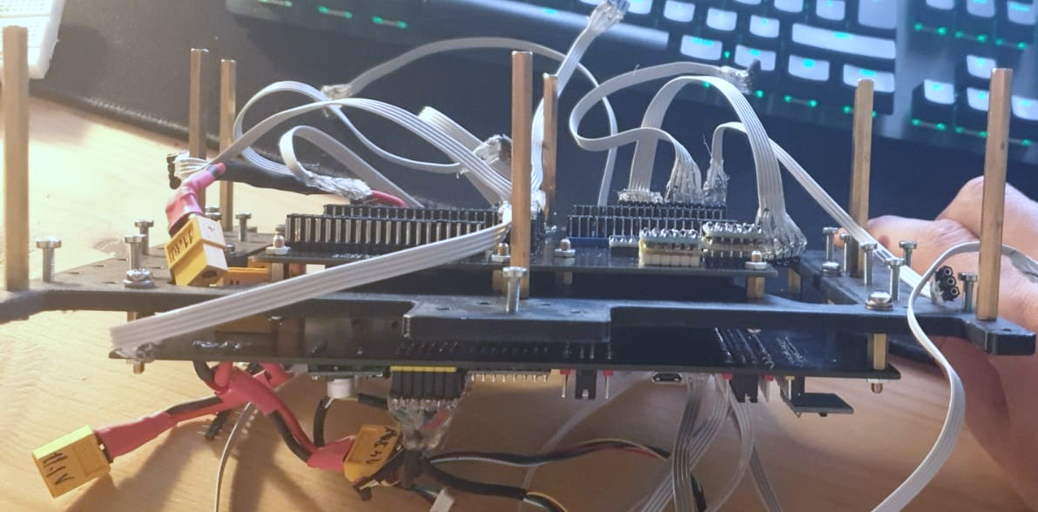
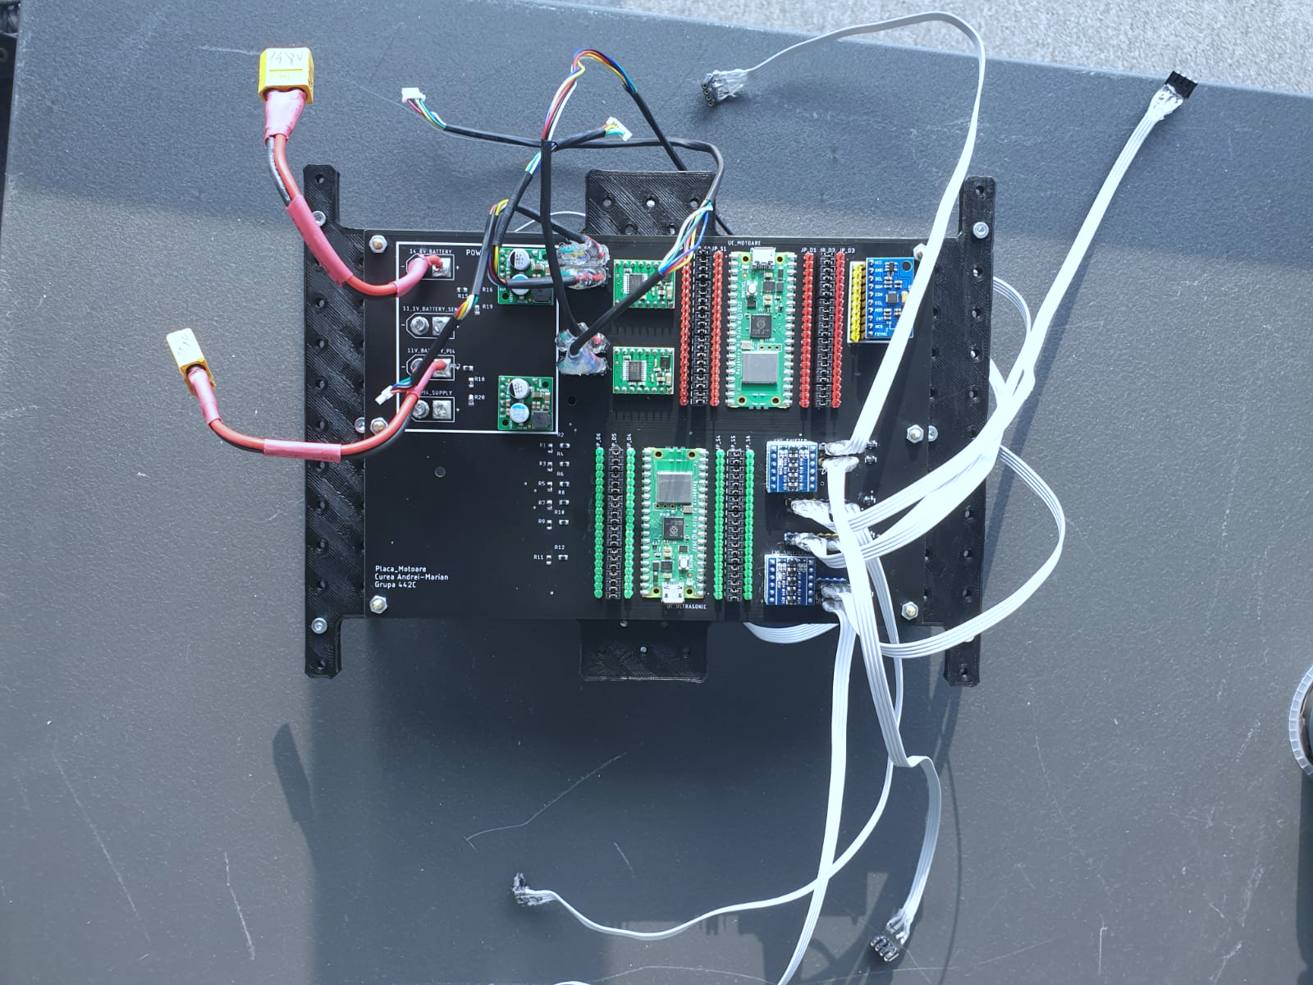
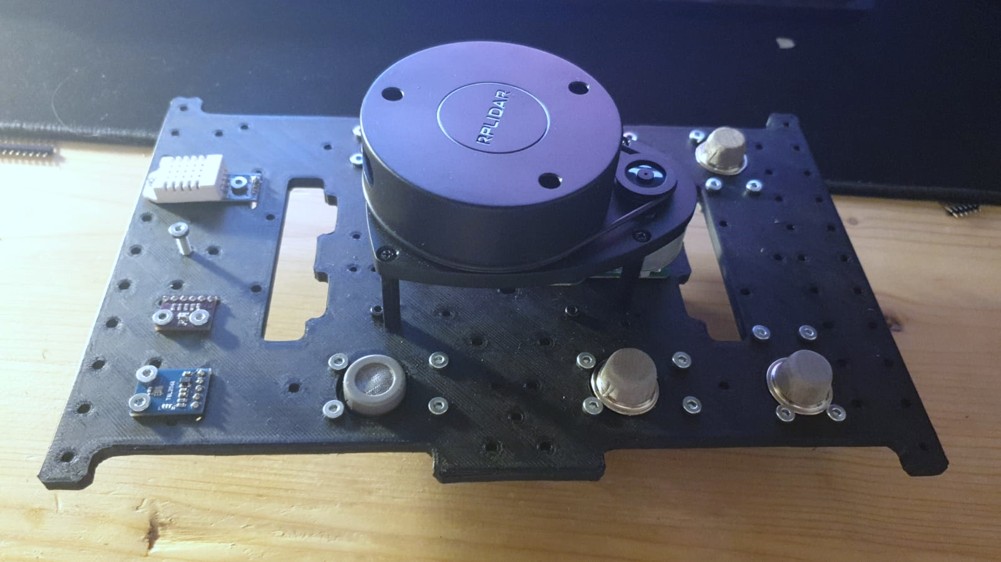
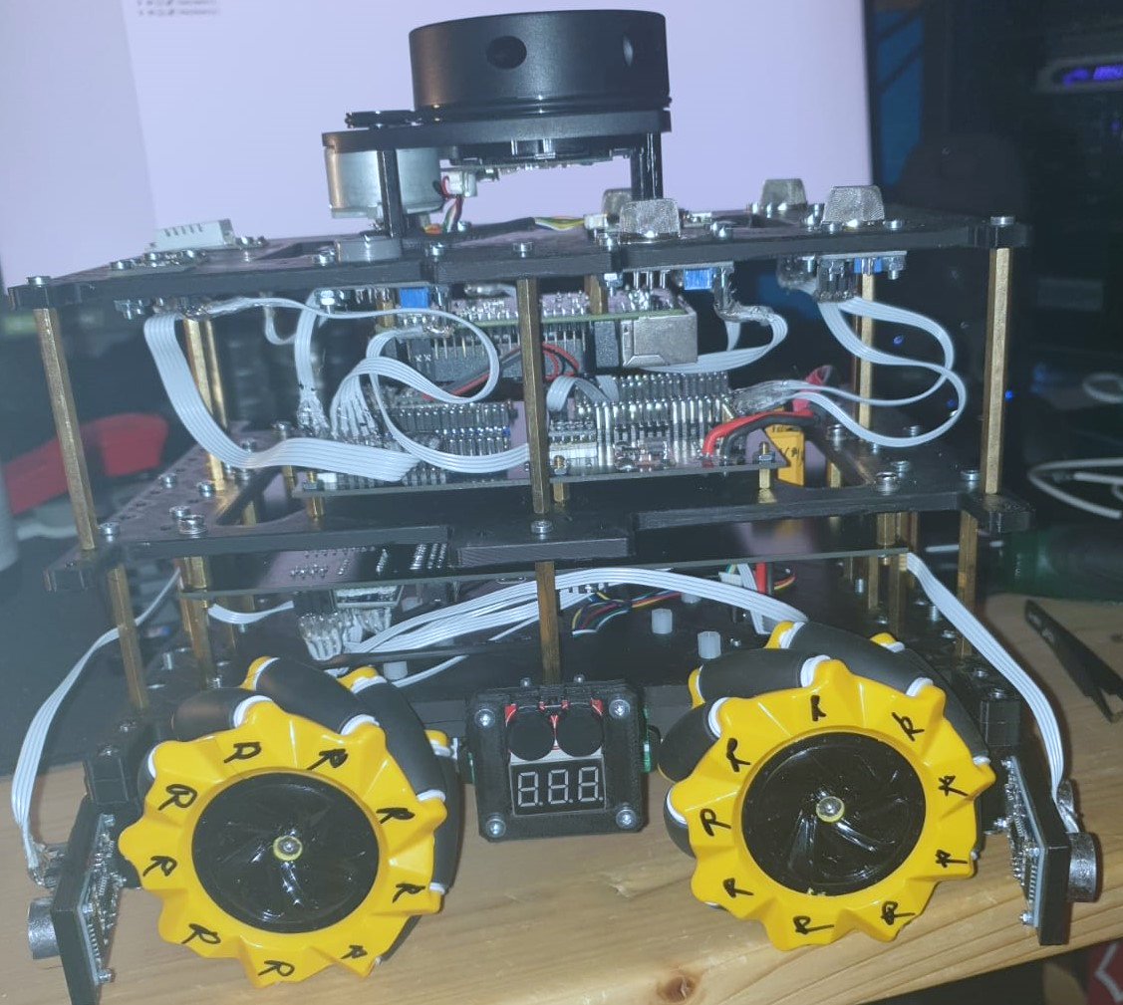
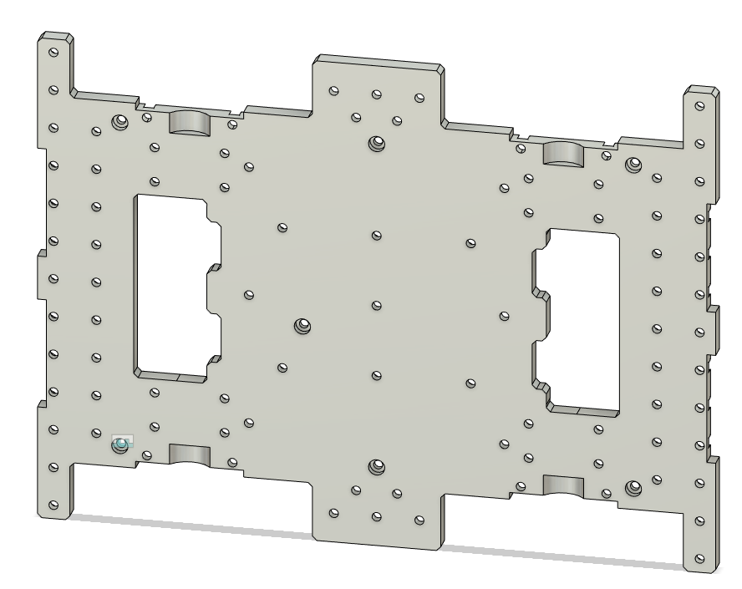
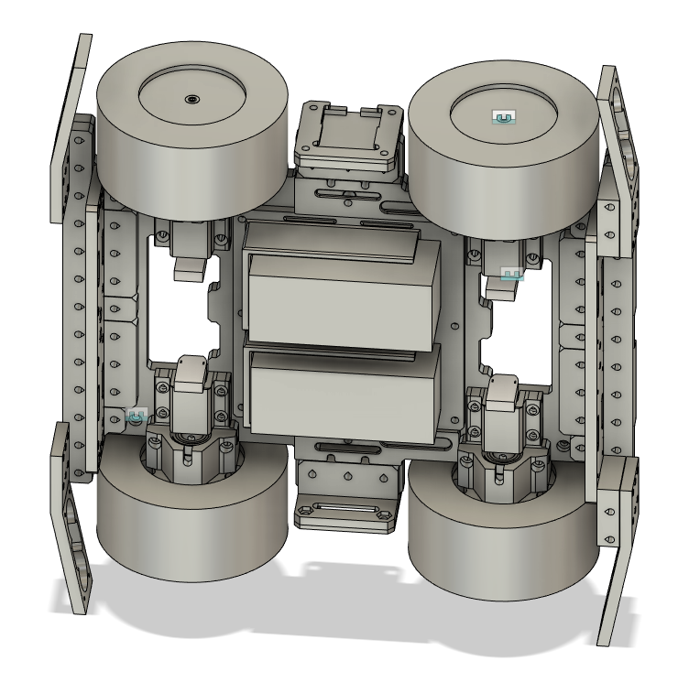
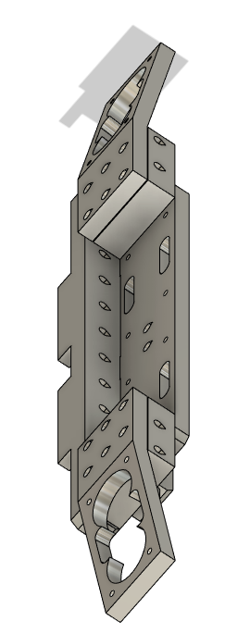
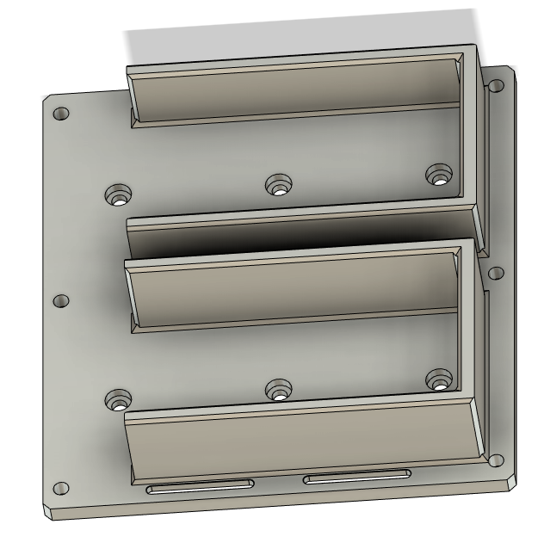
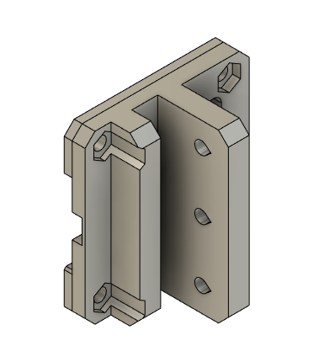
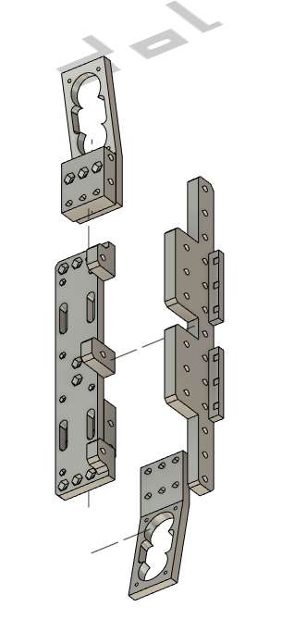
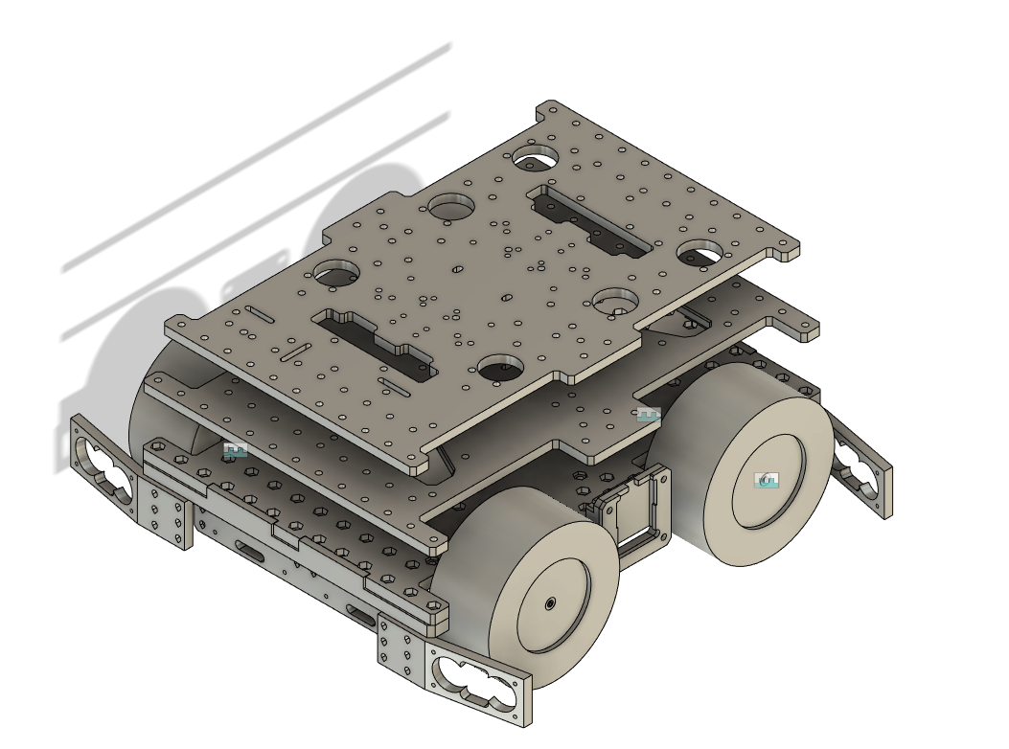

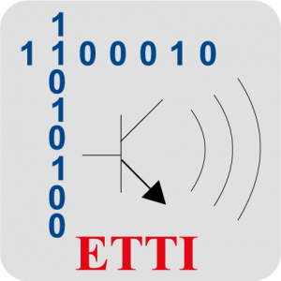
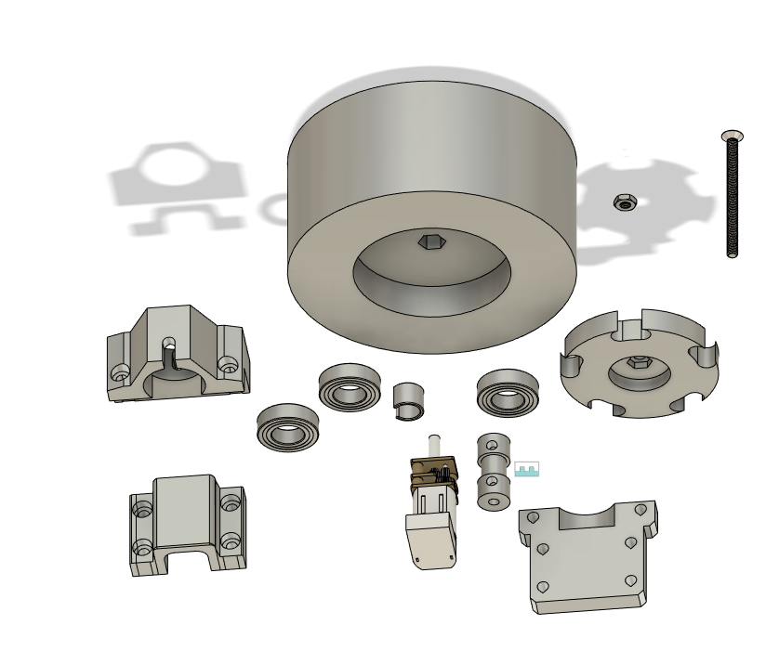


`
Semi-Autonomous Robot for Exploration, Mapping and Air Quality Monitoring
Ing. Andrei Curea Dr. Ing. Alexandru Antonescu
Motivation
2. Exploration Robots Principles
Air quality monitoring has become an ever increasing need for us to make data driven decisions, and stand a chance against the effects of our fast industrial growth on ourselves and on the planet.
Urbanization accelerates:
Increased need for energy and industries;
Increased hazardous emissions;
Public health and environmental concerns;
Critical urgency for automation:
Can be scaled up fast;
Reduces risk for toxic exposure;
Reduces overall cost of data
acquisition;
Existing solutions are:
Stationary;
Costly to scale up;
This project attempts to:
Bridge the gap between existing air quality monitoring modules, and autonomous exploration and mapping;
Create a versatile single-platform that can be used from a safe distance from a hazardous place;
An exploration robot needs the following:
A way to sense the environment (proximity, encoder or acceleration sensors);
Custom designed chassis for traversing the explored environment;
Exploration algorithms;
SLAM algorithms;
Onboard powerful computer;
Transmitting live/recorded data remotely;
Usually, the exploration and mapping aren’t the main purposes of the already existing robots. They are application specific platforms, and need to adopt supplementary sensors and capabilities, on top of the above detailed architecture.
On our platform, we intent to:
Apply the exploration robot principles for office and industrial indoor environments;
Add sensors and procedures for acquiring environmental and air quality data;
Path Planning
Active Perception
Localization
Exploration
SLAM
Mapping
ASLAM (Active Simultaneous Localization and Mapping) diagram
Example of ASLAM implementation indoors
4. Mechanical System
3. Sensors & Electronics
3. Sensors & Electronics
Advanced mobility:
Omni-Directional wheels;
Low Center of gravity;
Well fastened accessories;
Powerful motors;
Rubberized wheels;
Durable & relatively lightweight chassis:
Quality 3D Printed Plastics;
Reinforced fasteners;
Structural integrity by key-point placed spacers;
Ease of life:
Dedicated cable management space;
Parametric 3D design (very easy to scale up);
Highly accessible batteries;
Balanced tolerances for dimensional accuracy after 3D printing;
Modular design;
- Sensors:
VOC Measuring;
Ambiental;
Inertial (MPUs);
Proximity (LiDAR and ultrasonic);
Power Monitoring;
- Computing:
Raspberry Pi 4 SBC;
RP2040 based µControllers;
- Motors & Motor Drivers;
- Power delivery circuits;
- Highly modular custom PCBs & connectors; - Batteries;
- Sensors:
VOC Measuring;
Ambiental;
Inertial (MPUs);
Proximity (LiDAR and ultrasonic);
Power Monitoring;
- Computing:
Raspberry Pi 4 SBC;
RP2040 based µControllers;
- Motors & Motor Drivers;
- Power delivery circuits;
- Highly modular custom PCBs & connectors; - Batteries;
Control/movement diagram of the robot
Table with included sensors
The custom PCB and attached sensors
5. Capabilities
Customizable:
Extra holes added for future upgrades;
Layered design;
The proposed system achieves:
High Mobility Platform;
Measuring autonomy of 90 minutes (stationary);
Moving autonomy of 25 minutes;
Custom & modular chassis and PCBS;
Acquires a wide array of environmental parameters;
Can log data remotely;
Able to perform complex measuring routines;
Capable of obstacle avoidance;
Powerful SBC integrated;
First layer of the Robot for motors and battery mount
Assembled Robot
6. Future Development
The robot needs the following upgrades:
Wheel suspensions;
SLAM (Simultaneous Localization and Mapping) implementation;
Software improvements;
Better motors (preferably BLDCs);
Lighter Frame;
Bigger autonomy;
A dedicated battery charging station;
The entire custom 3D designed parts for the project
Contact Information:
- Ing. Andrei Curea – andrei.m_curea@yahoo.com
- Dr. Ing. Alexandru Antonescu – aantonescu@upb.ro

